Slide 1
Dovetailed Measuring Sticks

Slide 2
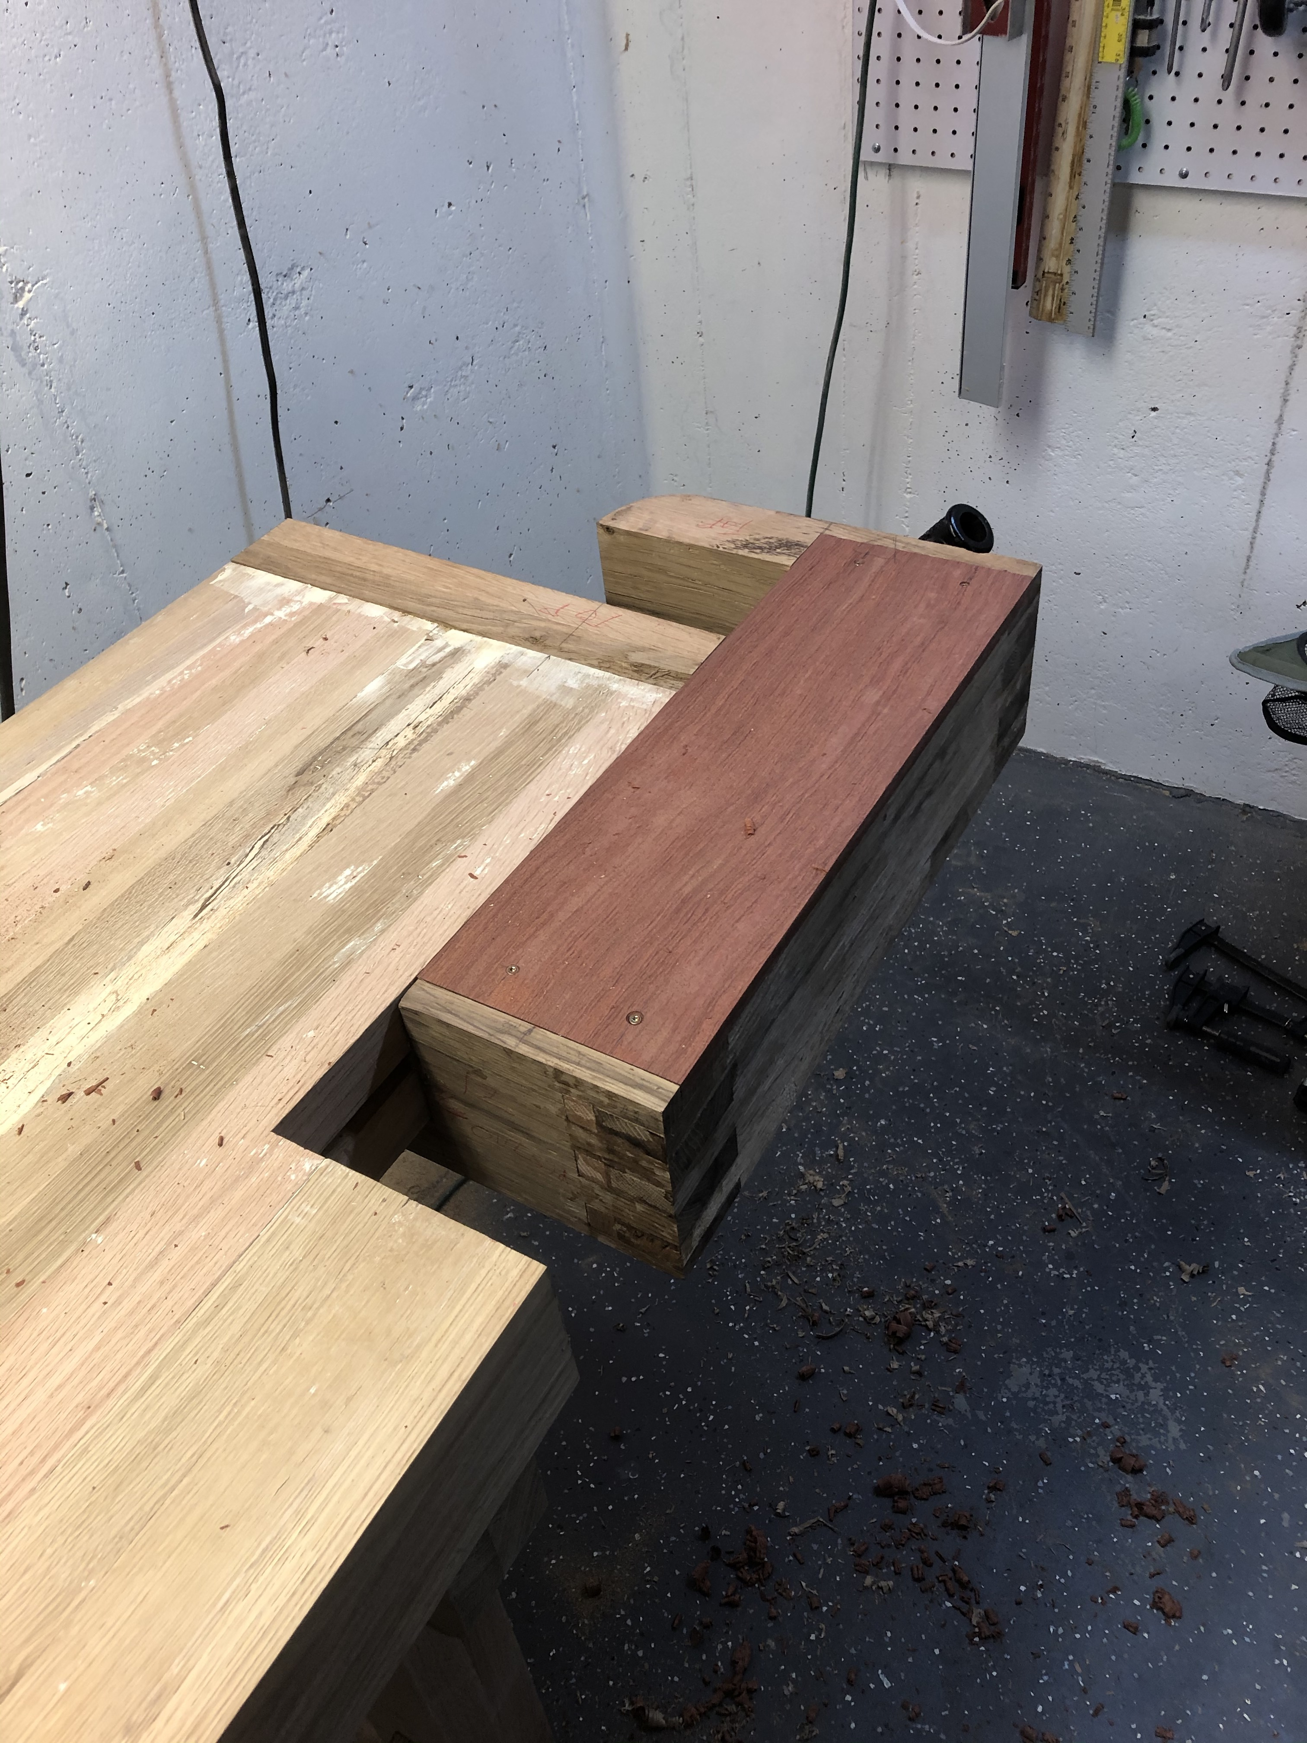

Slide 3
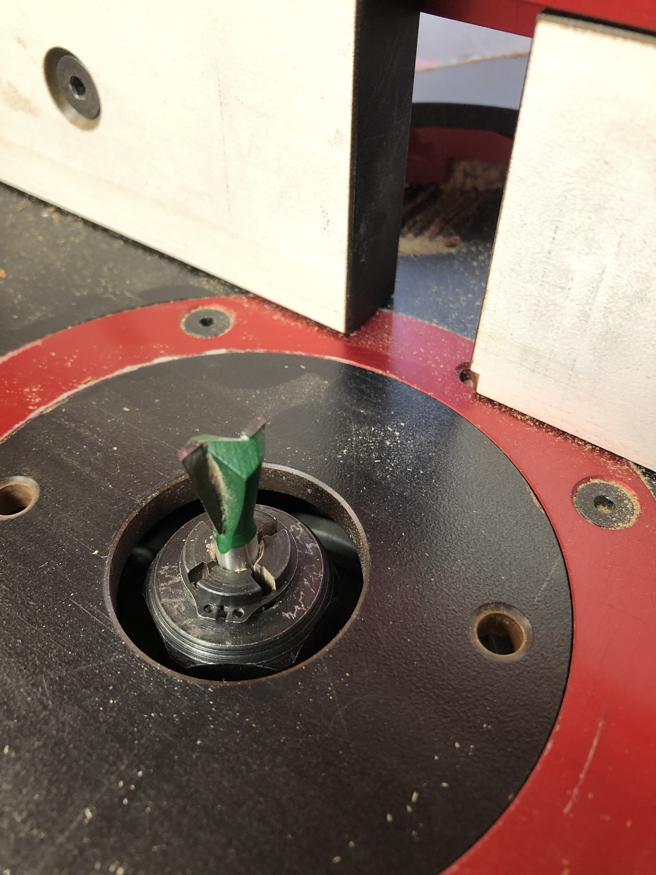
Dovetail Bit in Router table

Slide 4
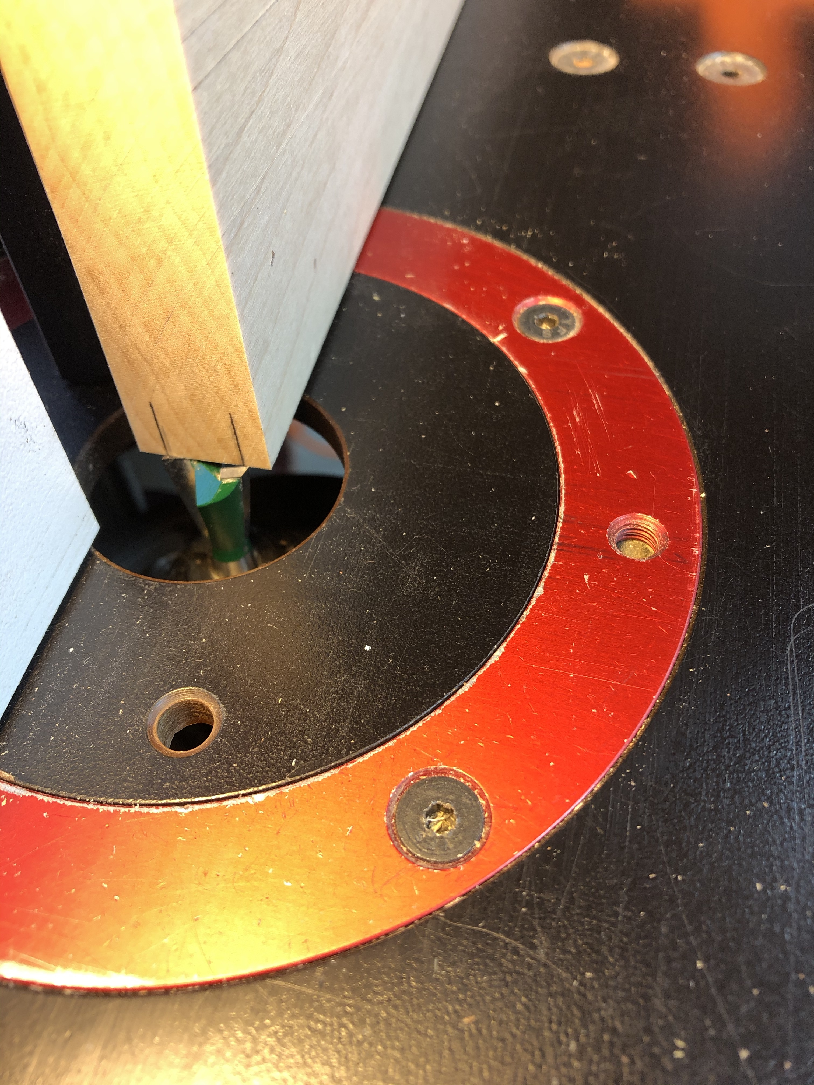
Center bit on board

Slide 5
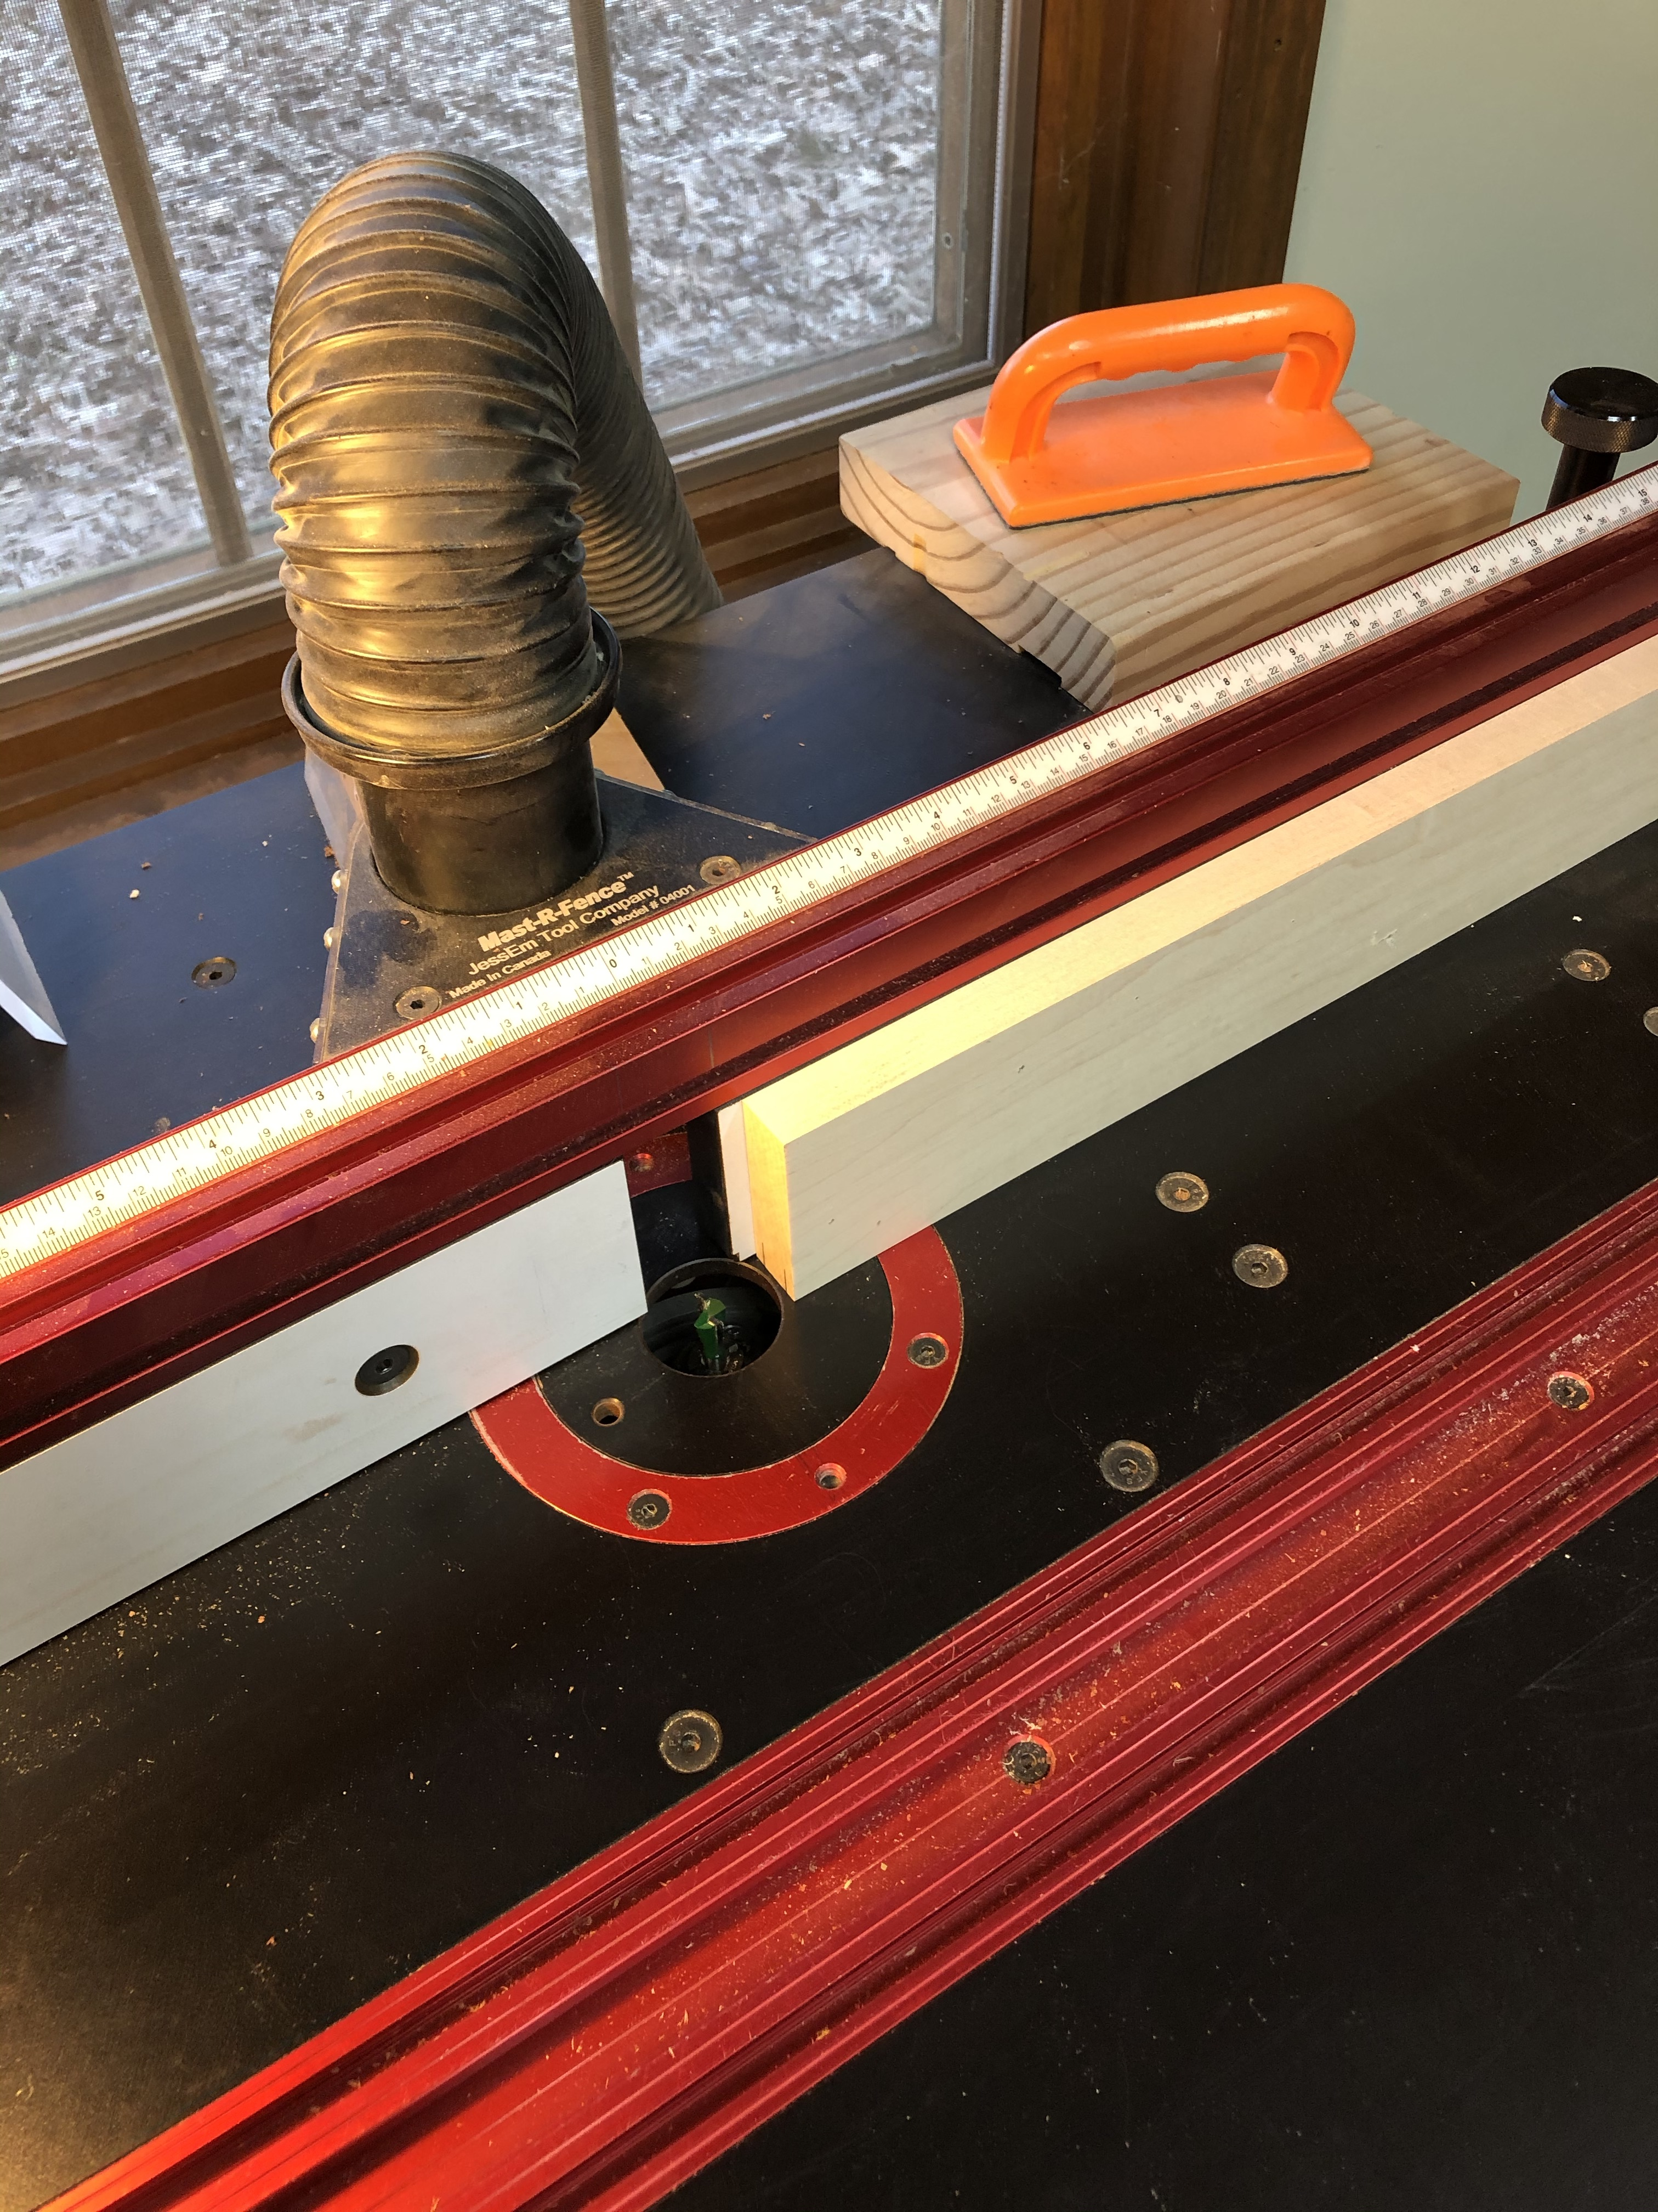
Ready to cut

Slide 6
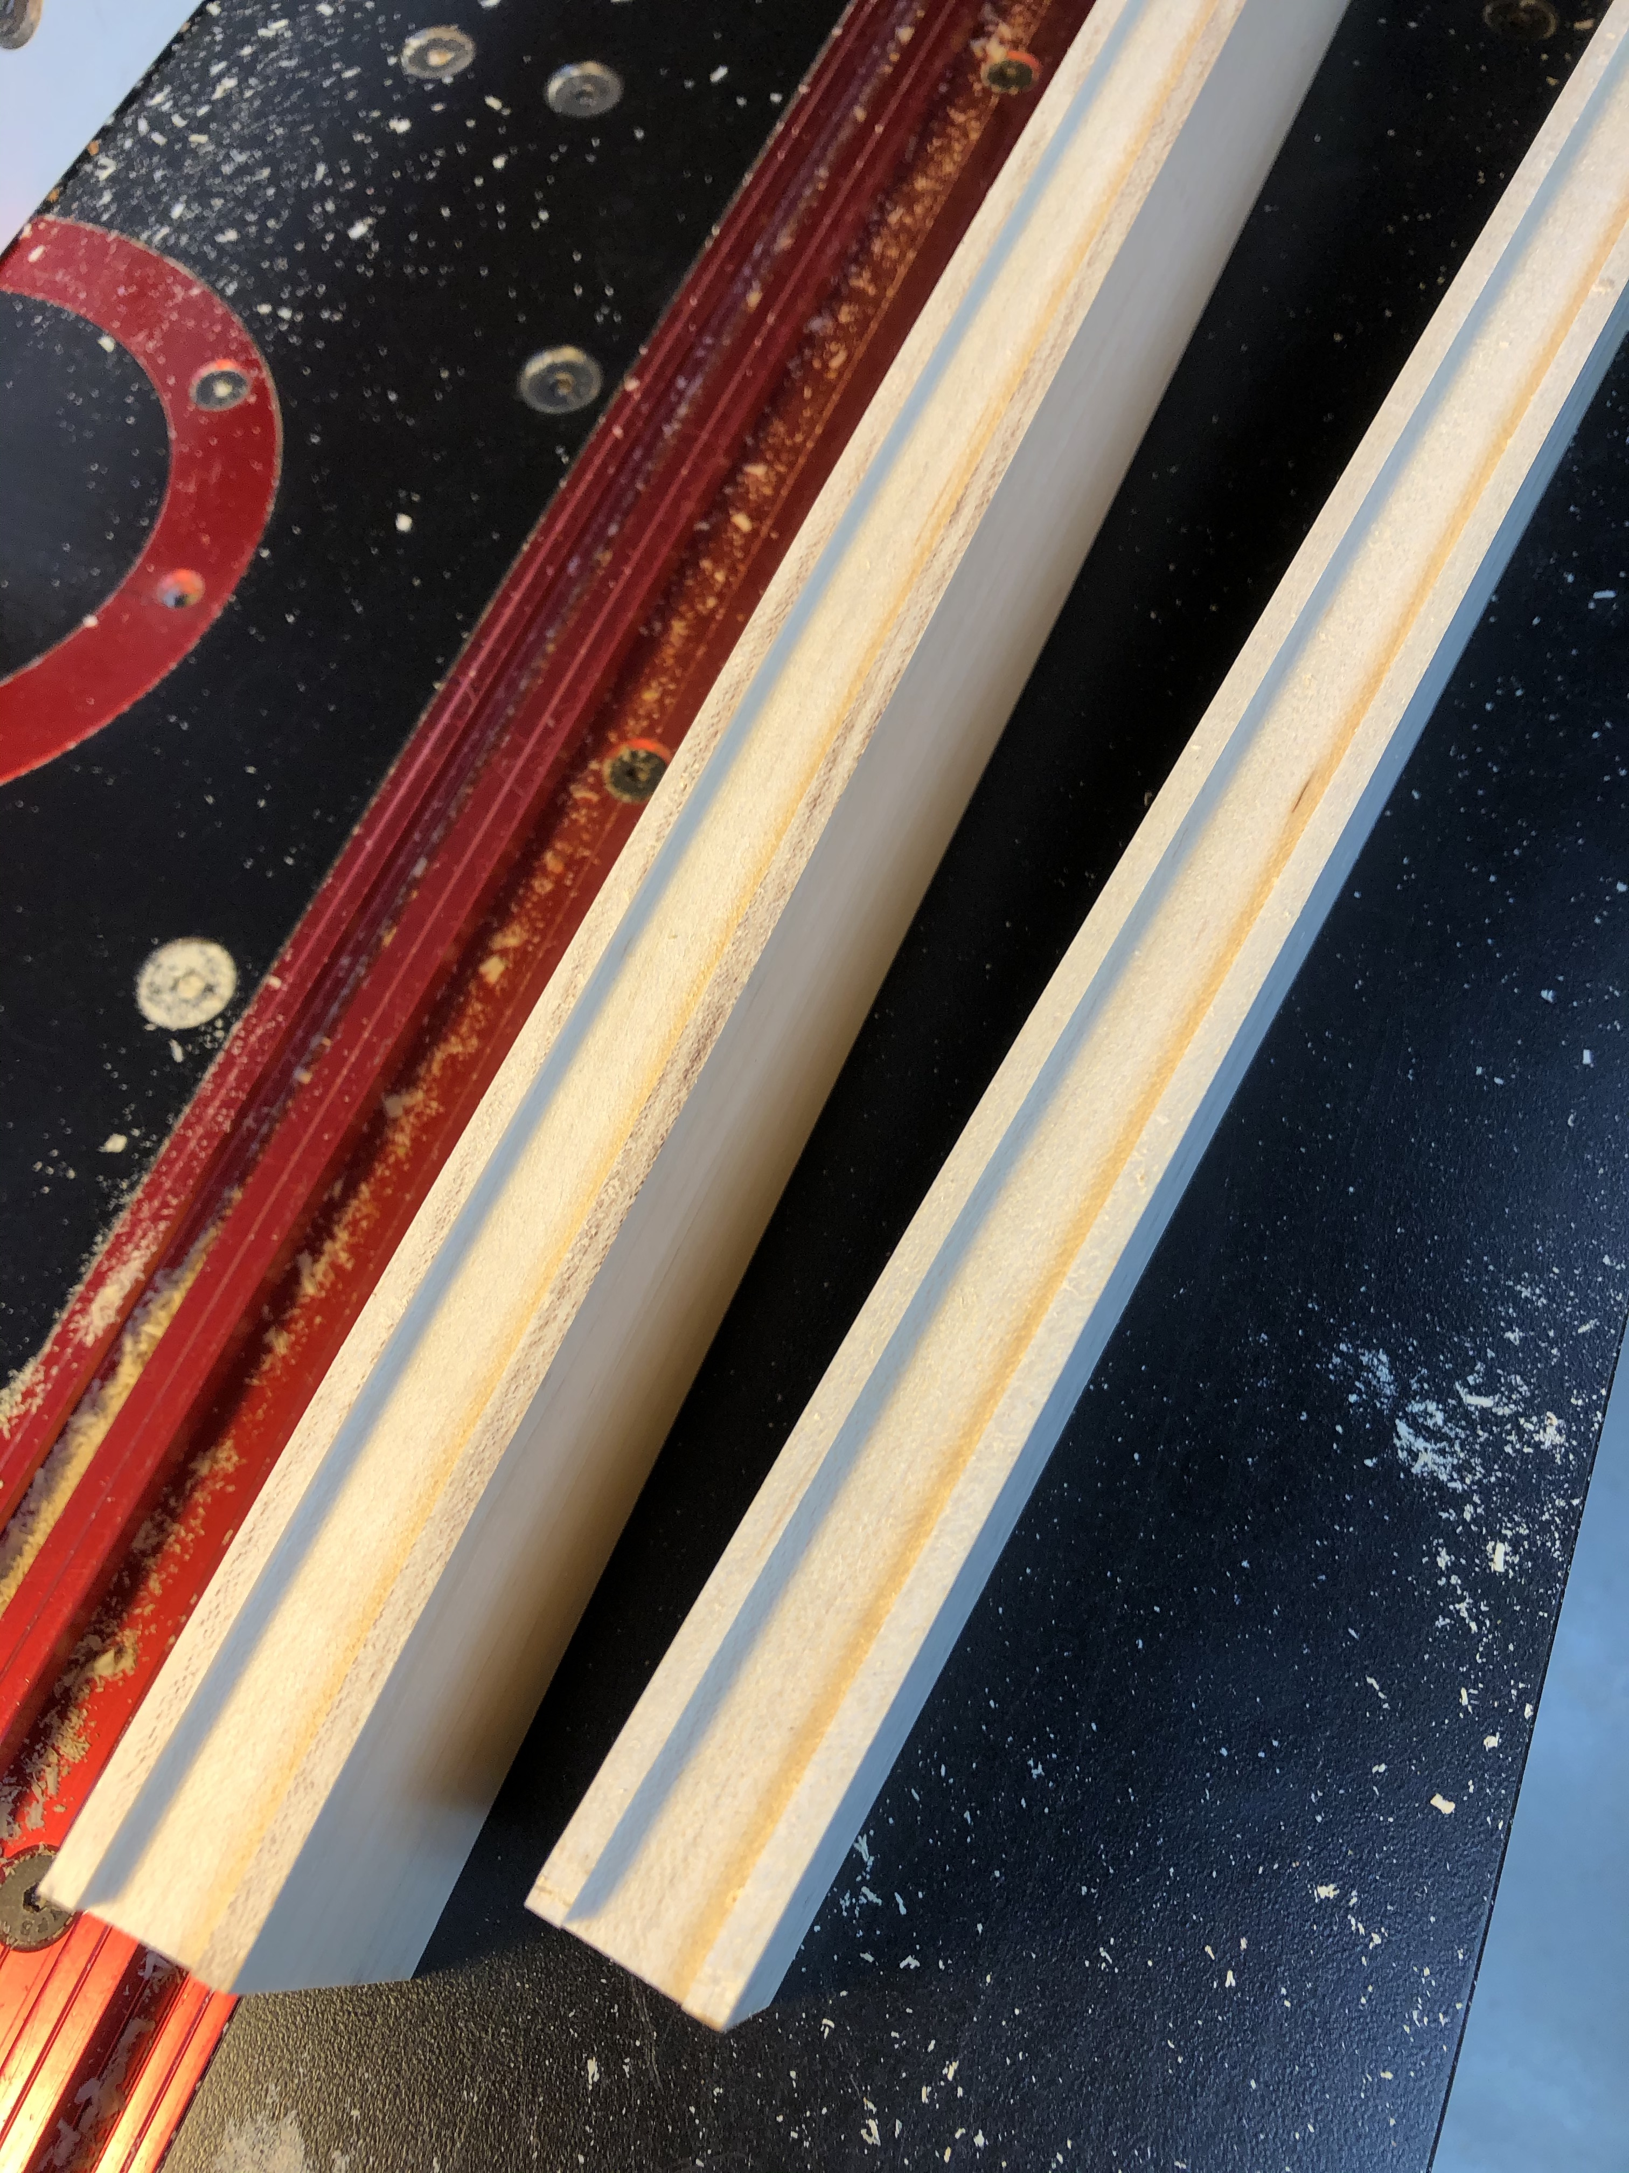
Cut dovetailed groove in edge of board.
Cut in both directions to ensure groove is in the center of the board

Slide 7
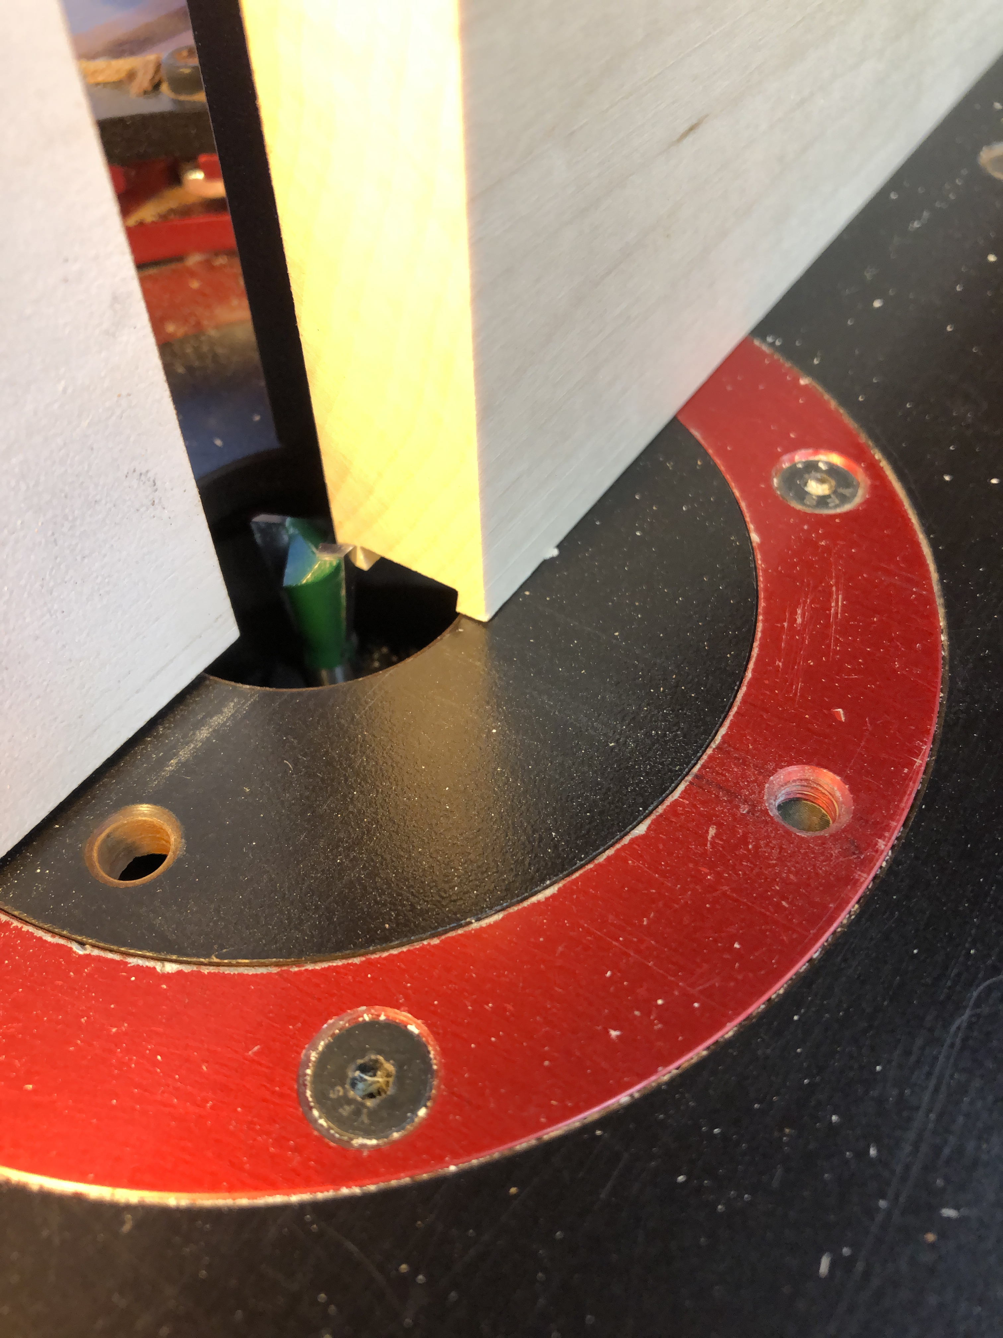
Move fence to cut dovetail on edge of board opposite the dovetail groove.

Slide 8
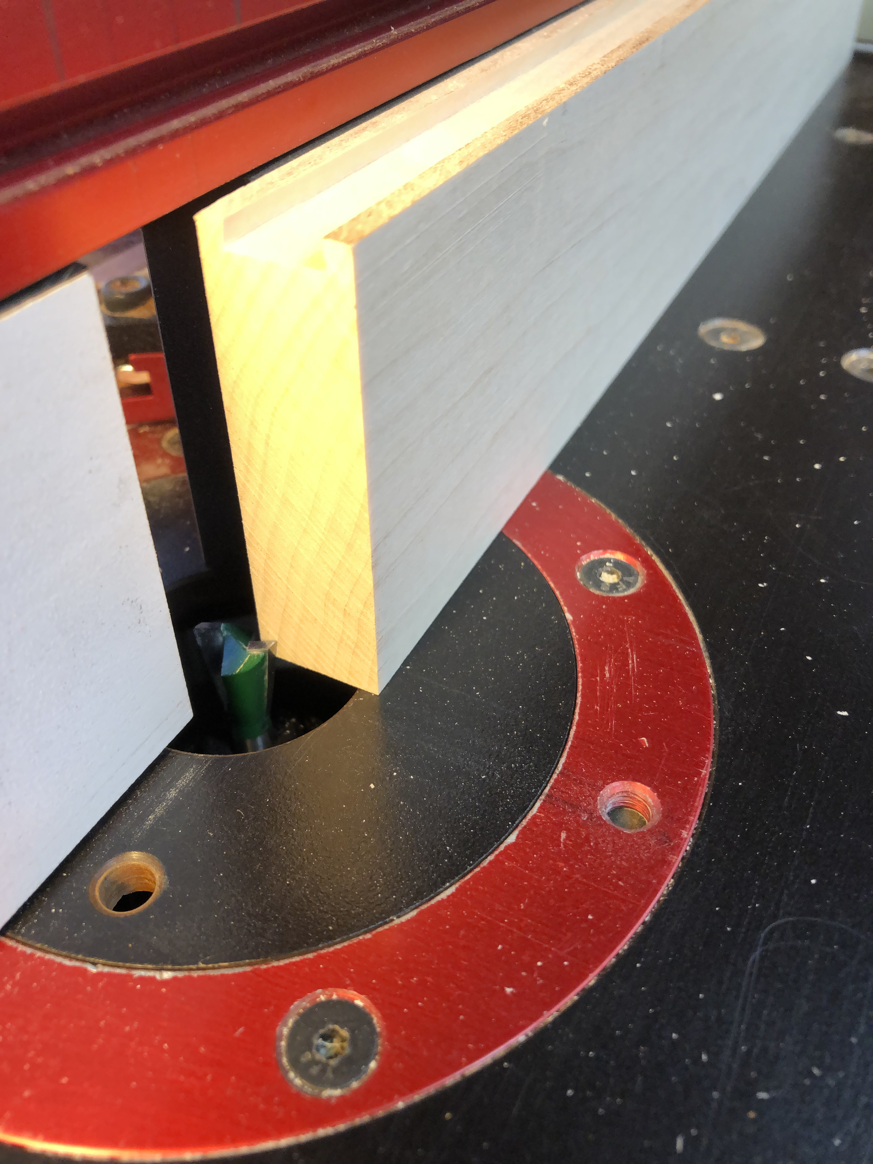
Cut dovetail on edge of board. Cut on one corner of board, then cut on other corner of board to ensure that dovetail is centered on edge of board.

Slide 9
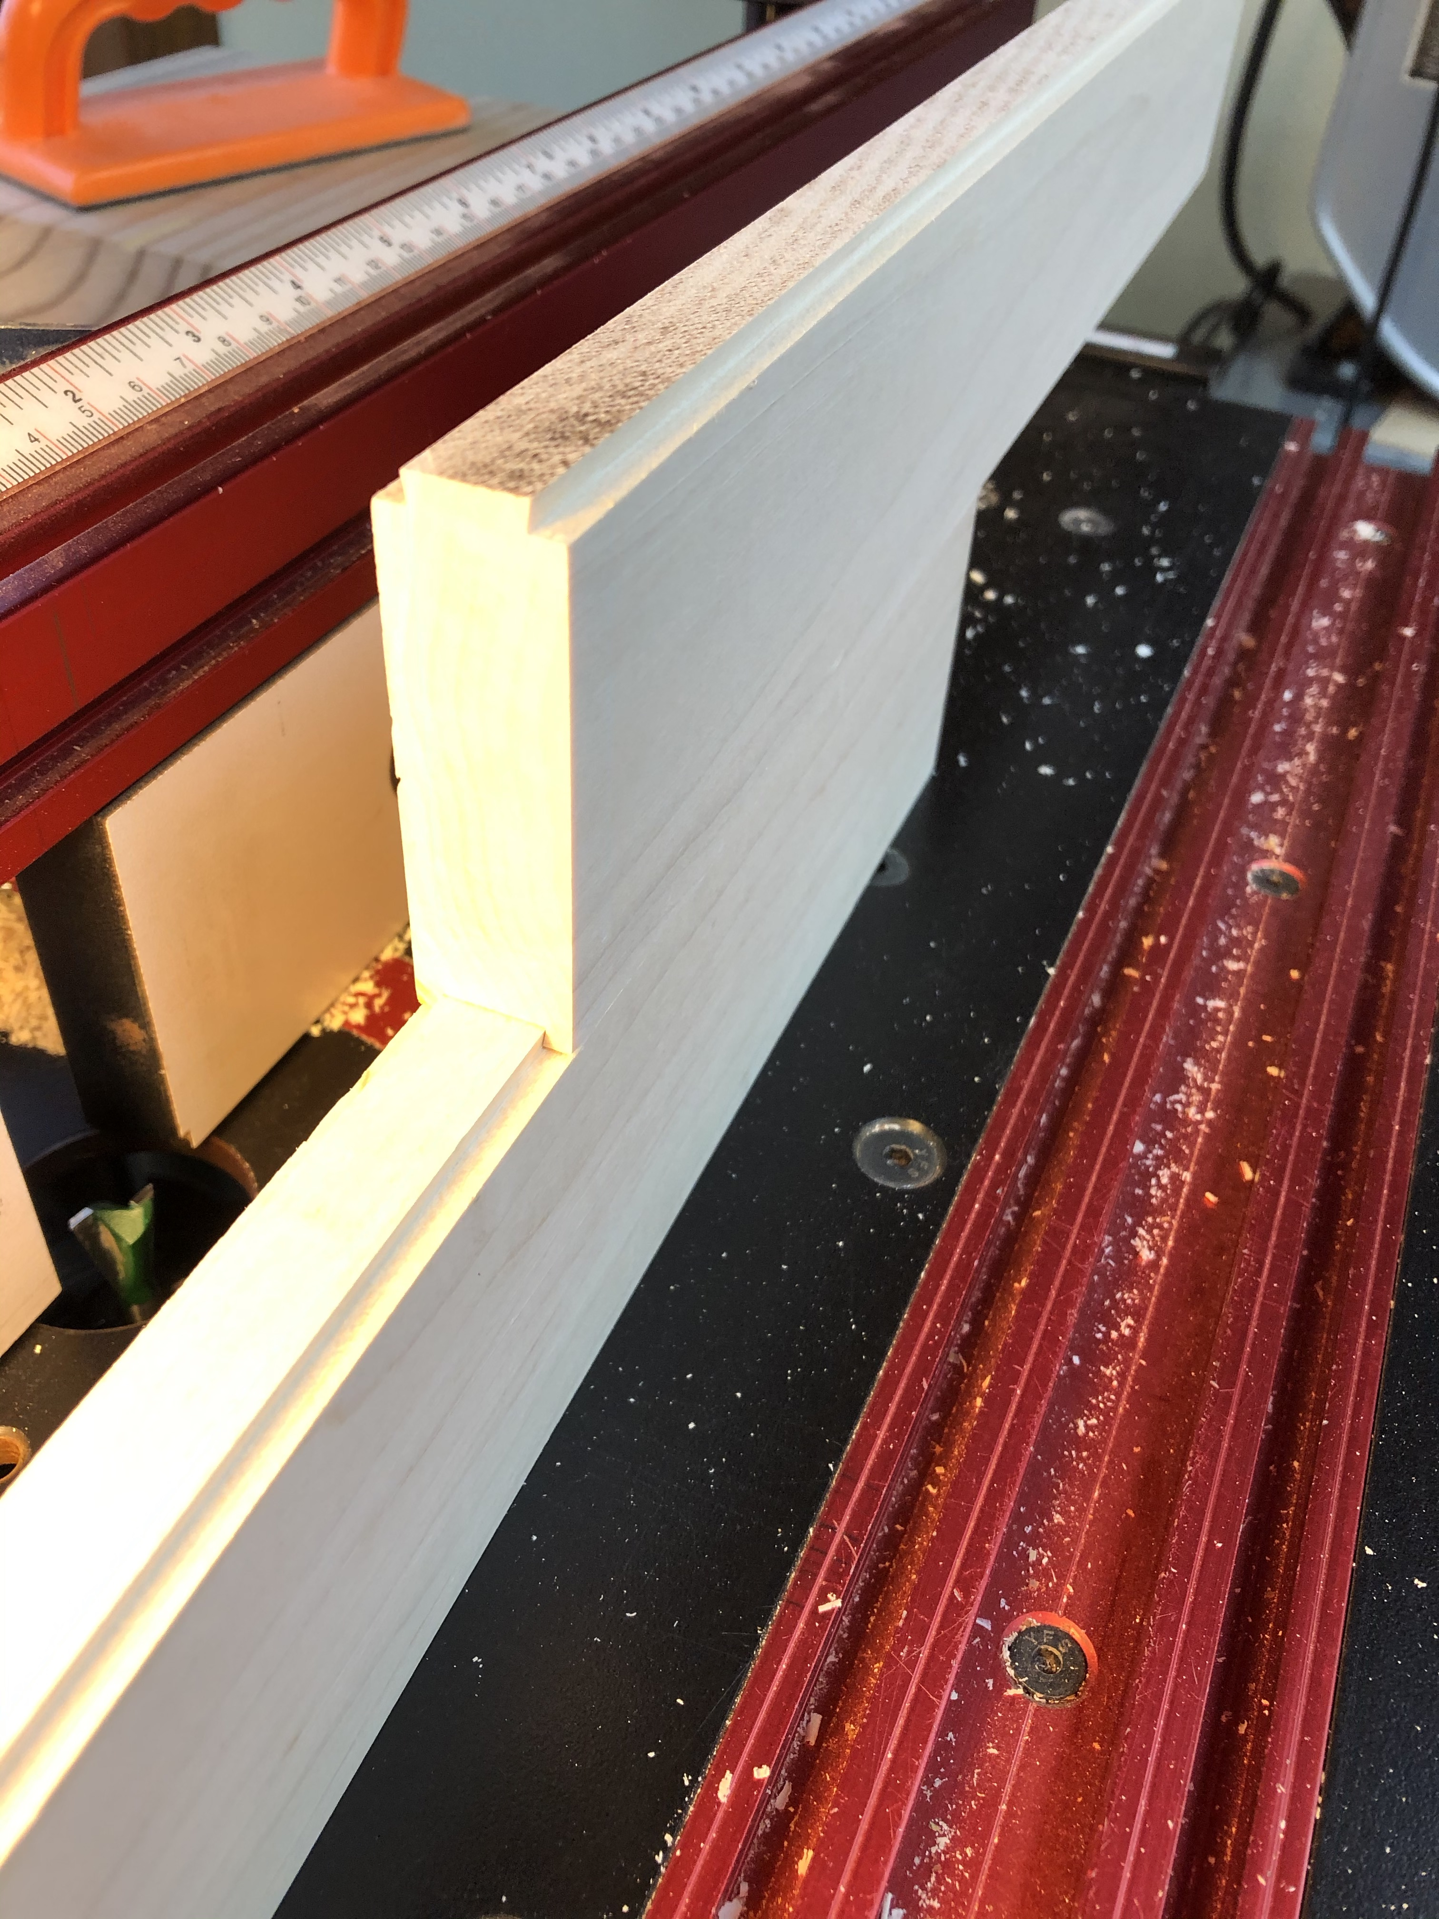
Test fit parts and continue to move fence until the dovetail tongue fits into the dovetail groove.

Slide 10
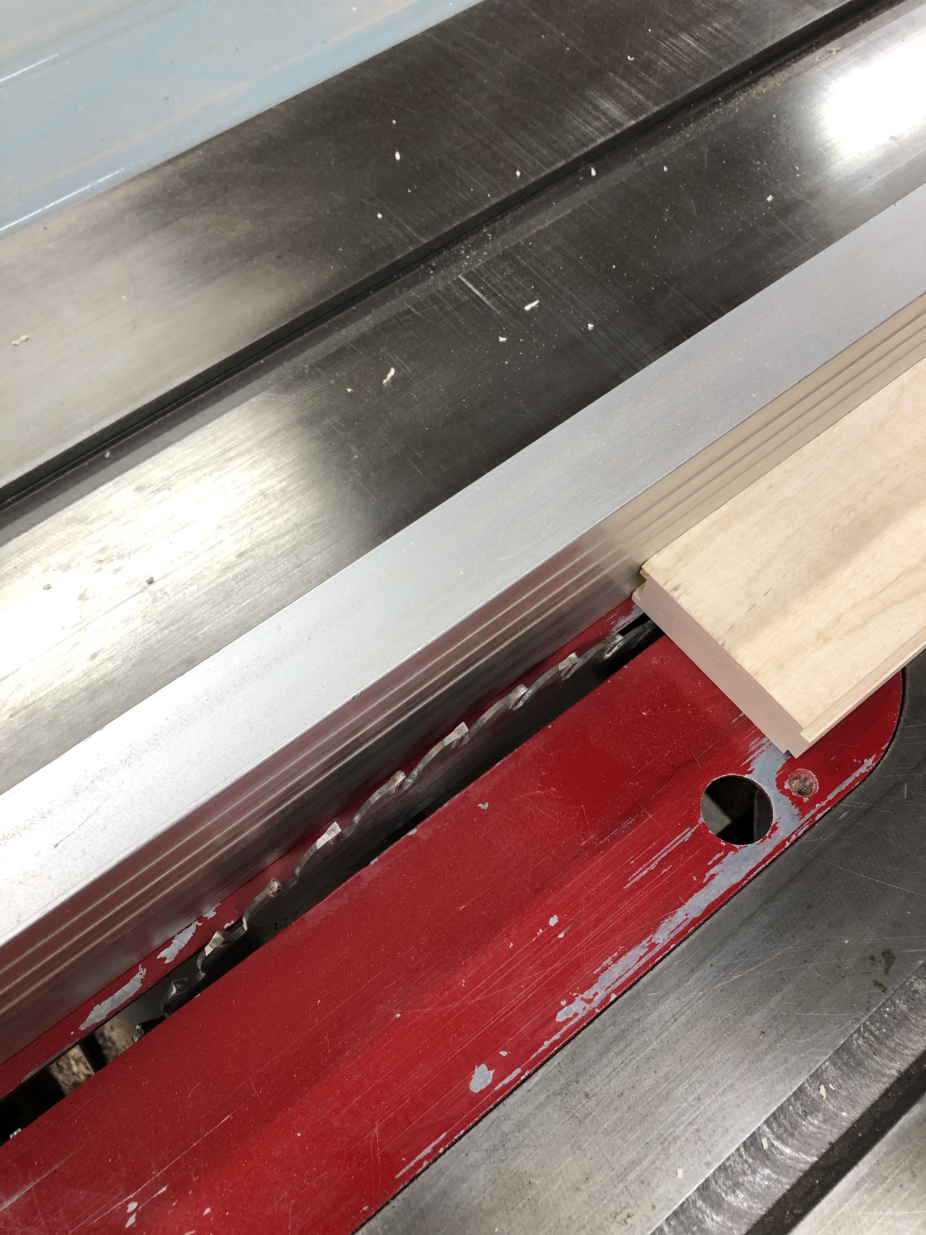
Rip dovetail groove from board.

Slide 11
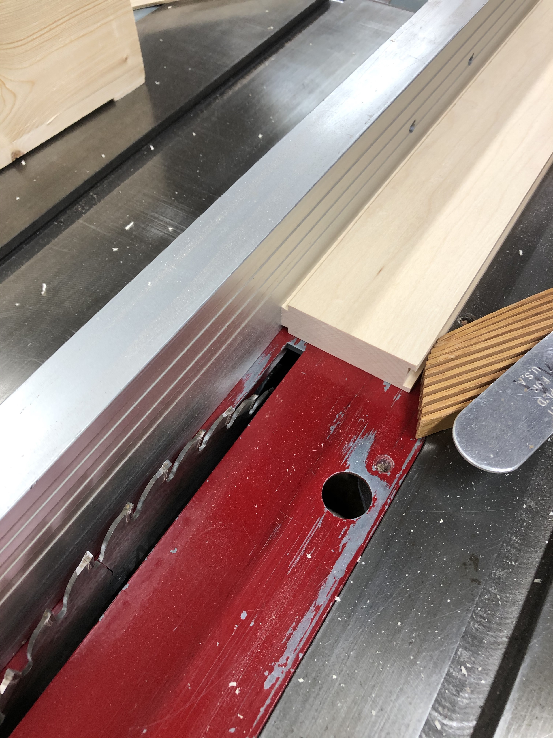
Rip dovetail “tongue” from board.

Slide 12
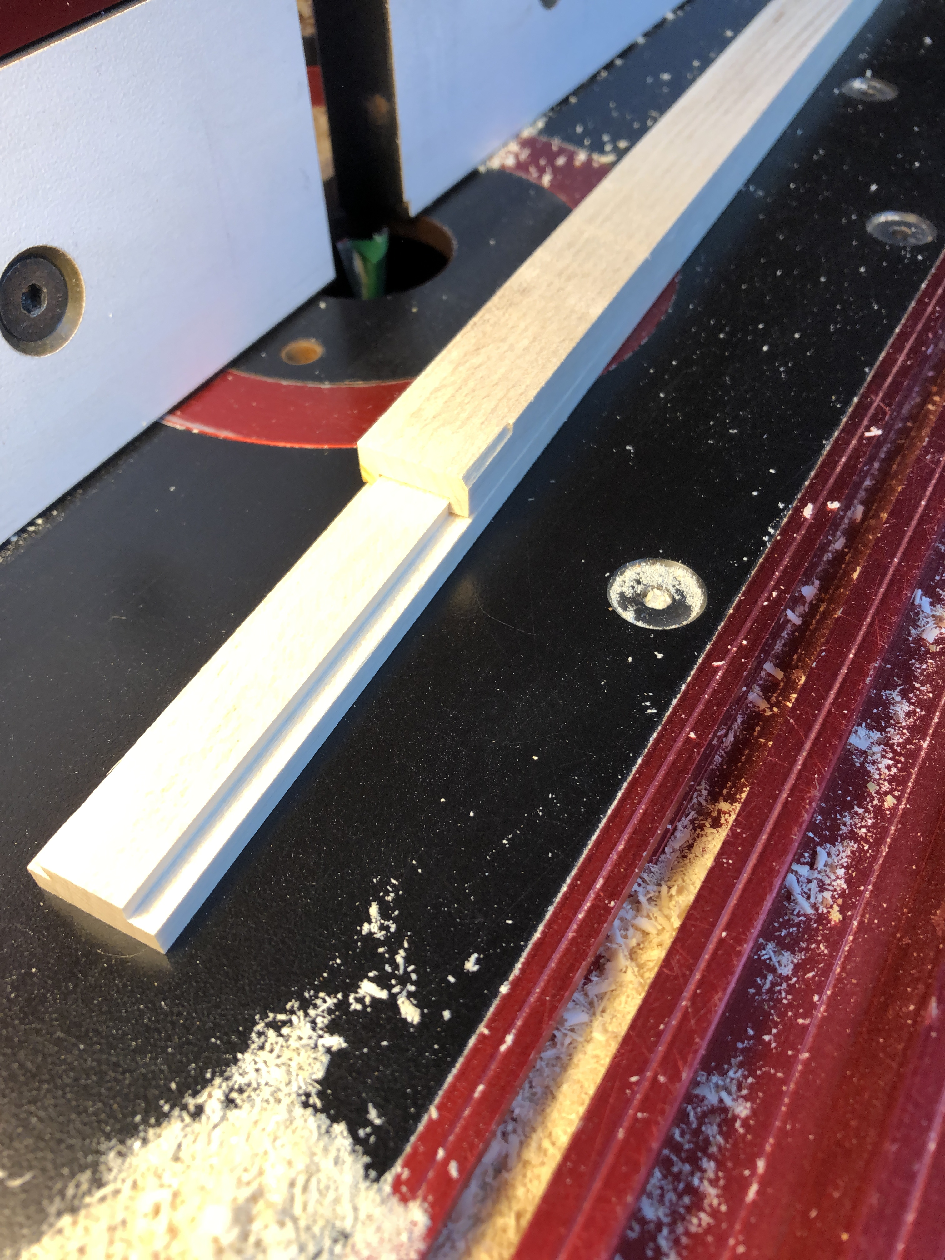
Two pieces of measuring stick fitted together.

Slide 13
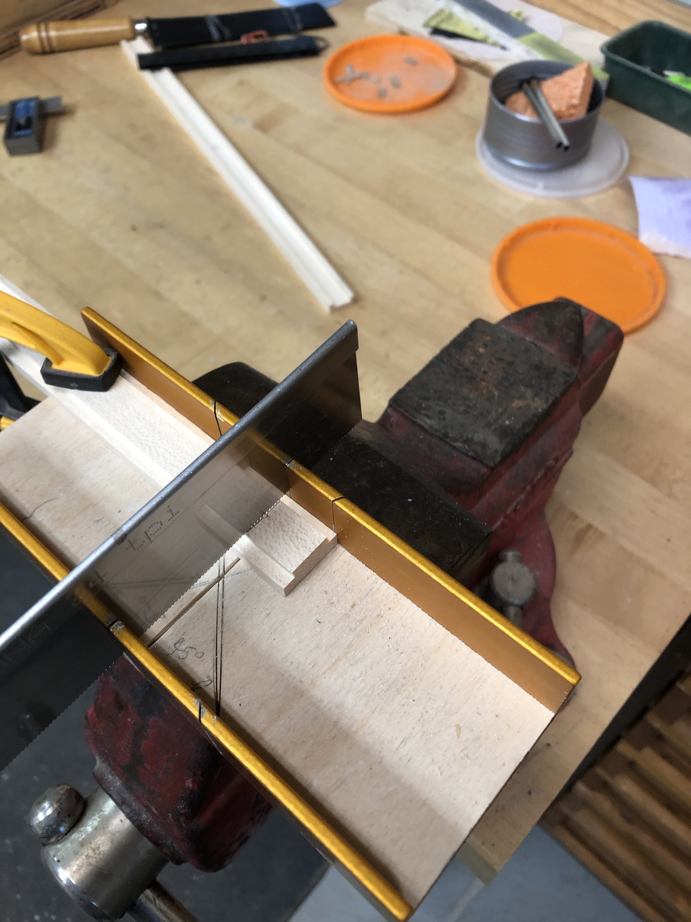
Cut a piece from each member 5/8” long

Slide 14
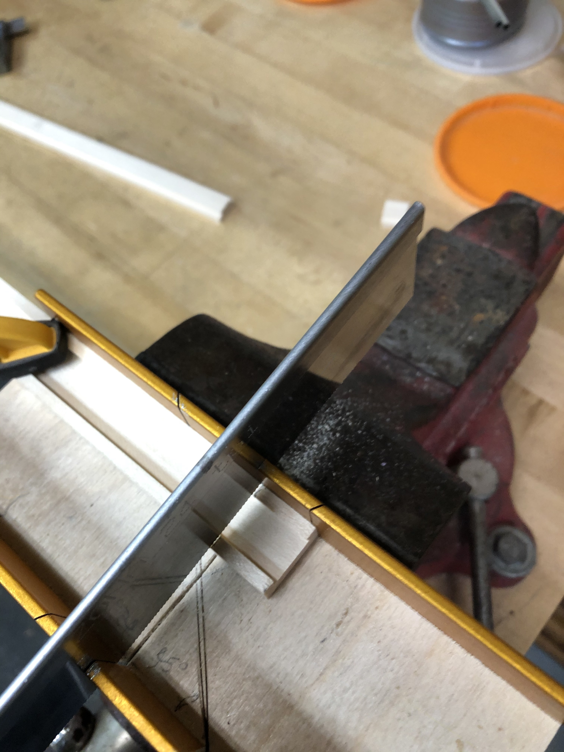

Slide 15
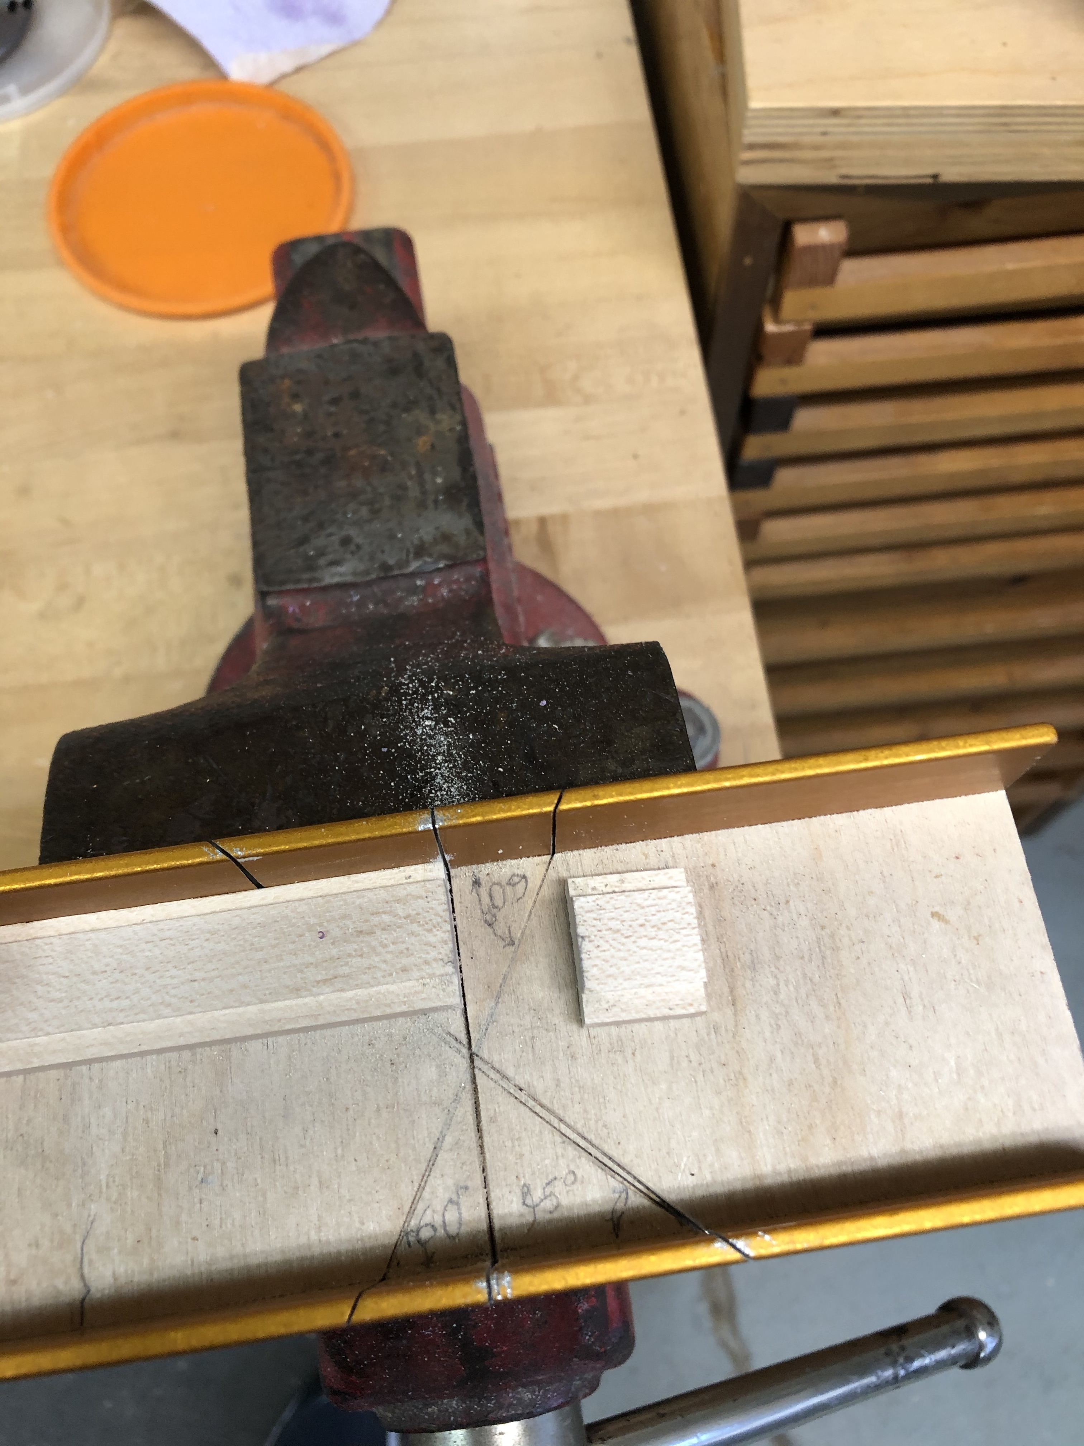
5/8” piece cut from dovetail tongue piece.

Slide 16
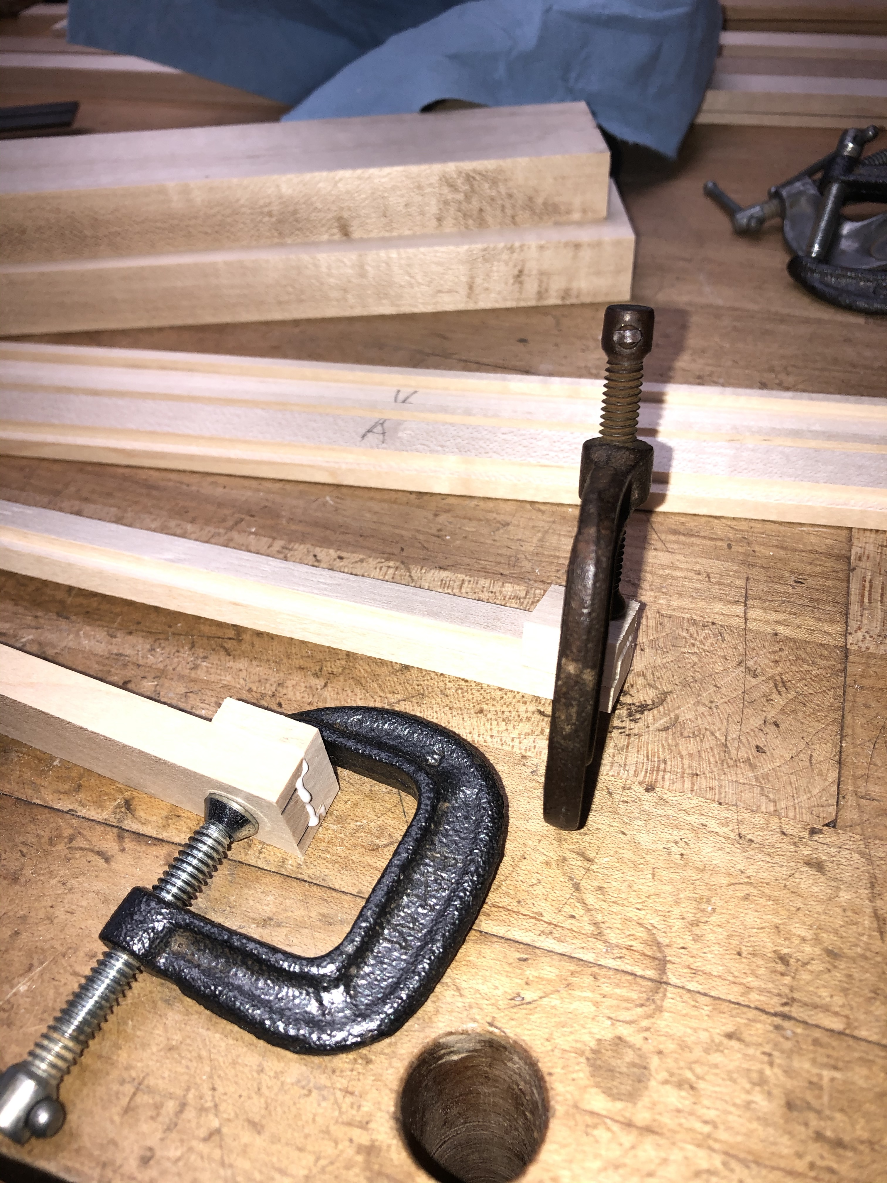
Glue 5/8” piece onto the end of the mating stick.

Slide 17
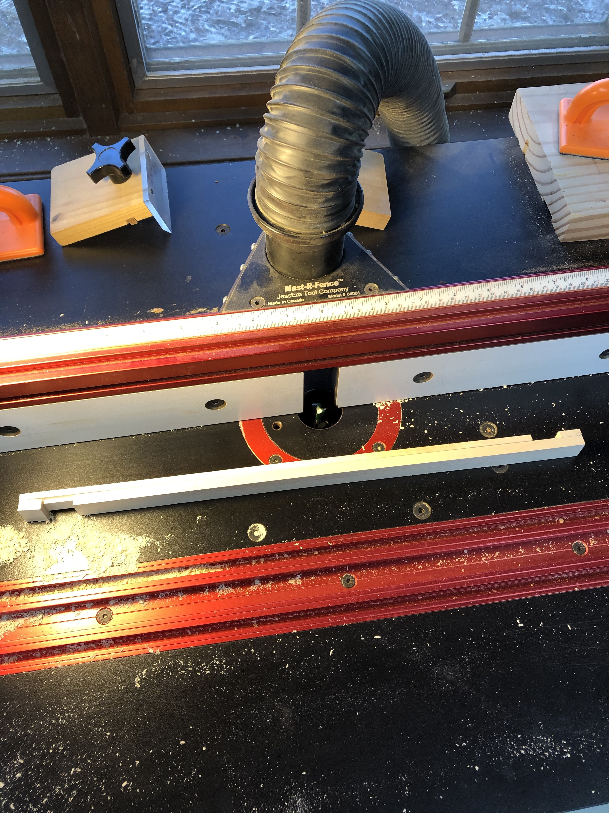
5/8” pieces glued onto the sticks.

Slide 18
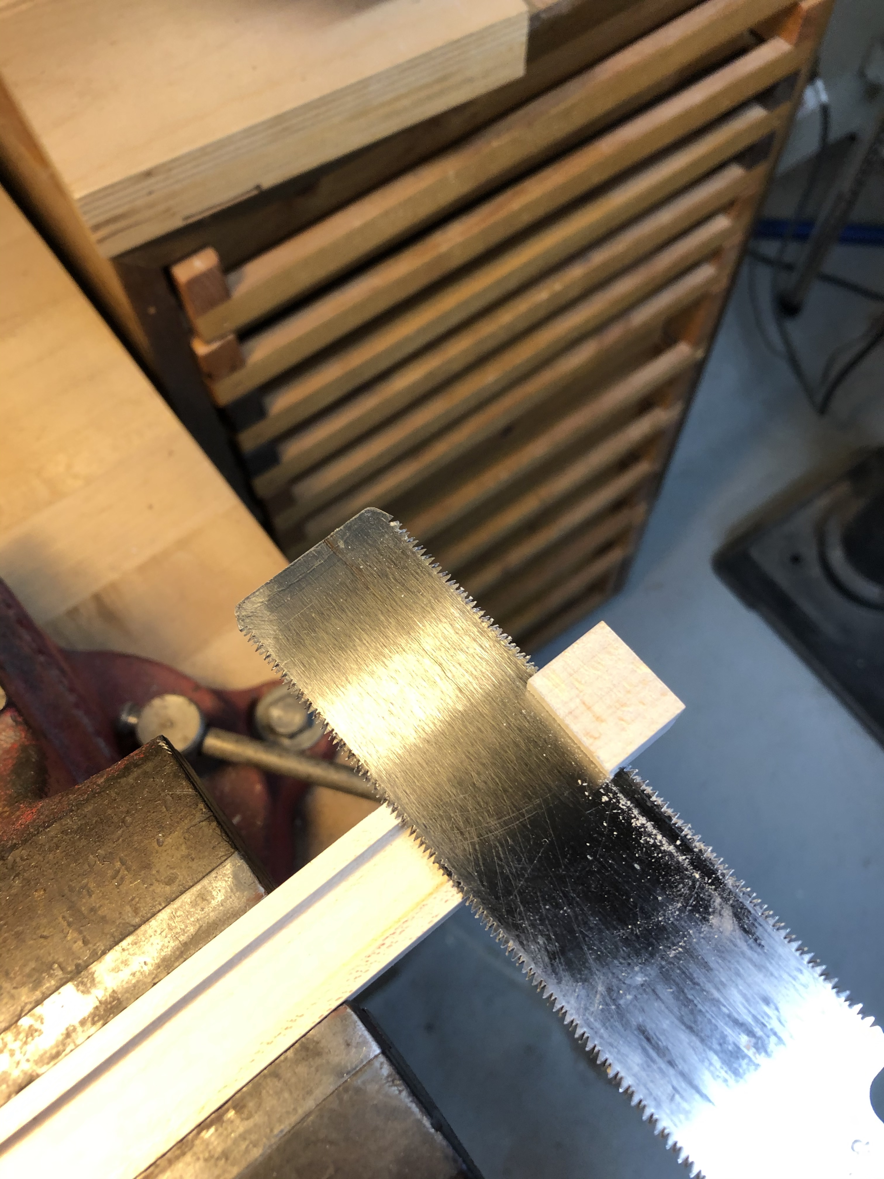
Cut the excess from the 5/8” pieces.

Slide 19
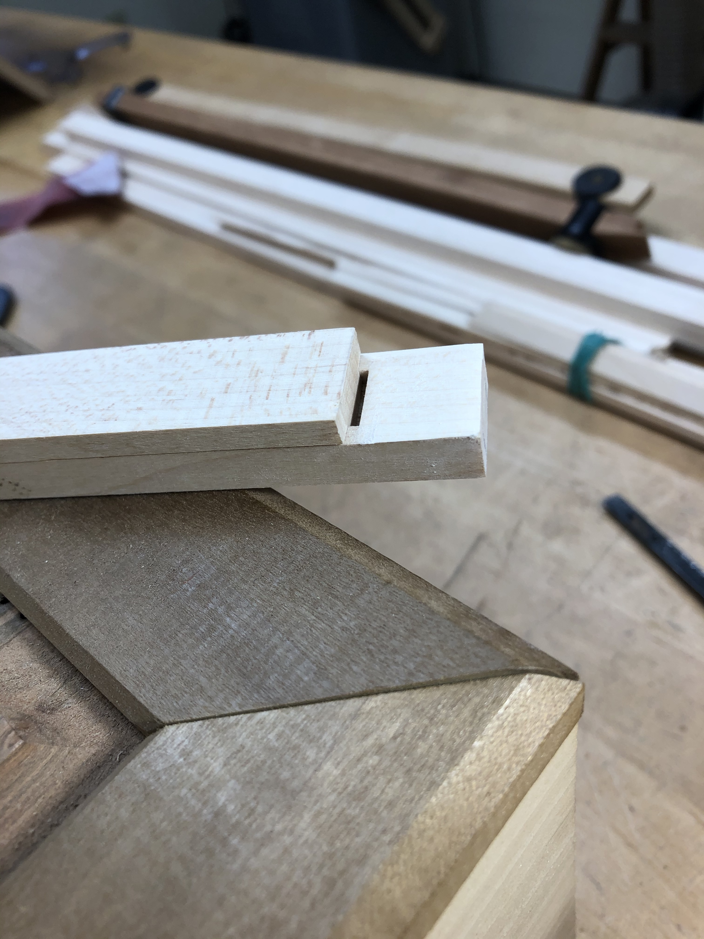
Excess cut from piece with dovetail groove. There is still interference that prevents the parts from over- lapping completely.

Slide 20
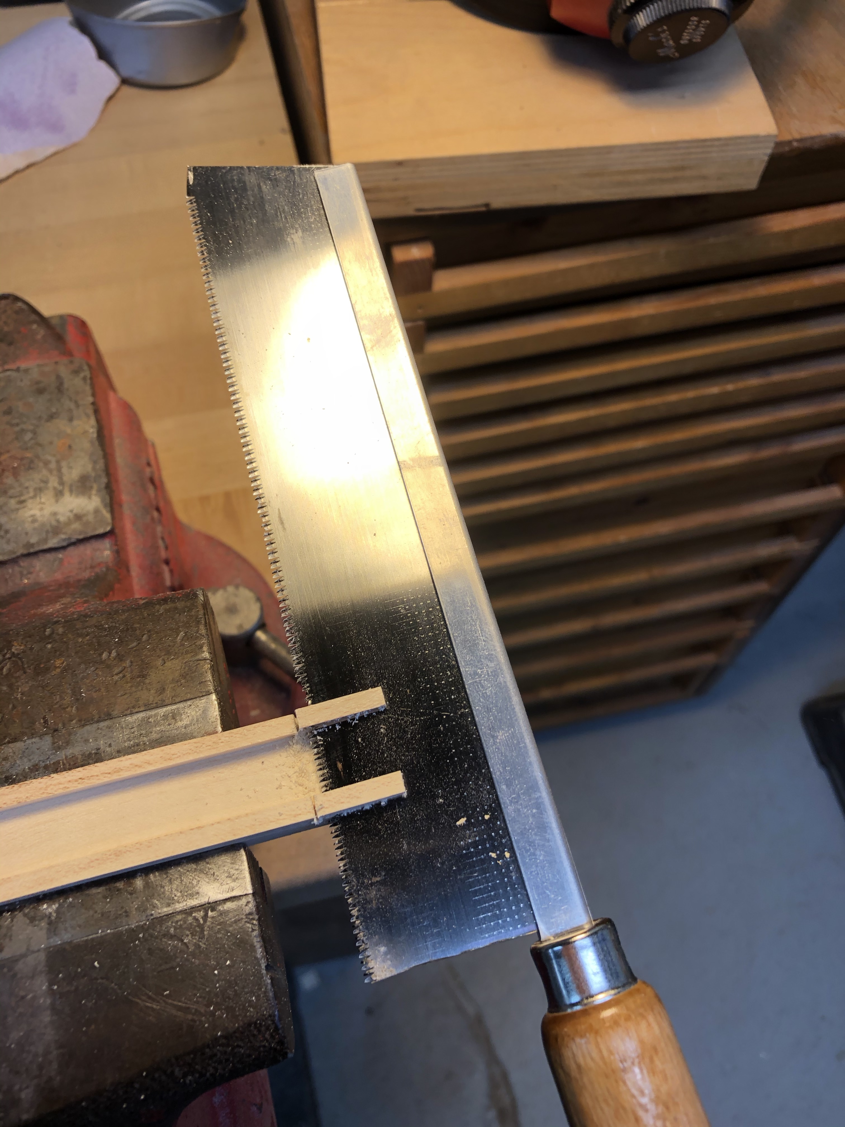
Cut off the parts that prevent complete overlapping.

Slide 21
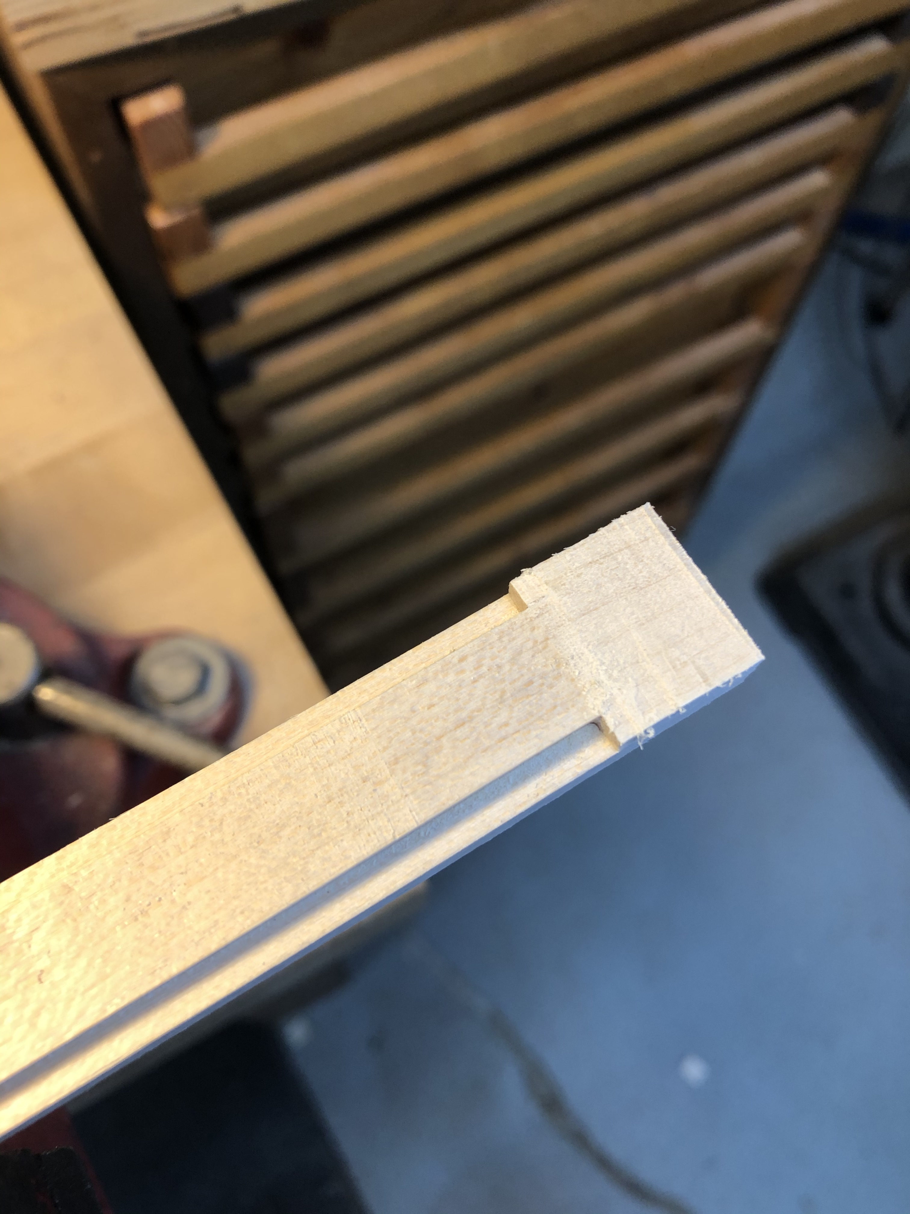
Dovetail piece with excess part of 5/8” block cut off with flush-cut saw.

Slide 22
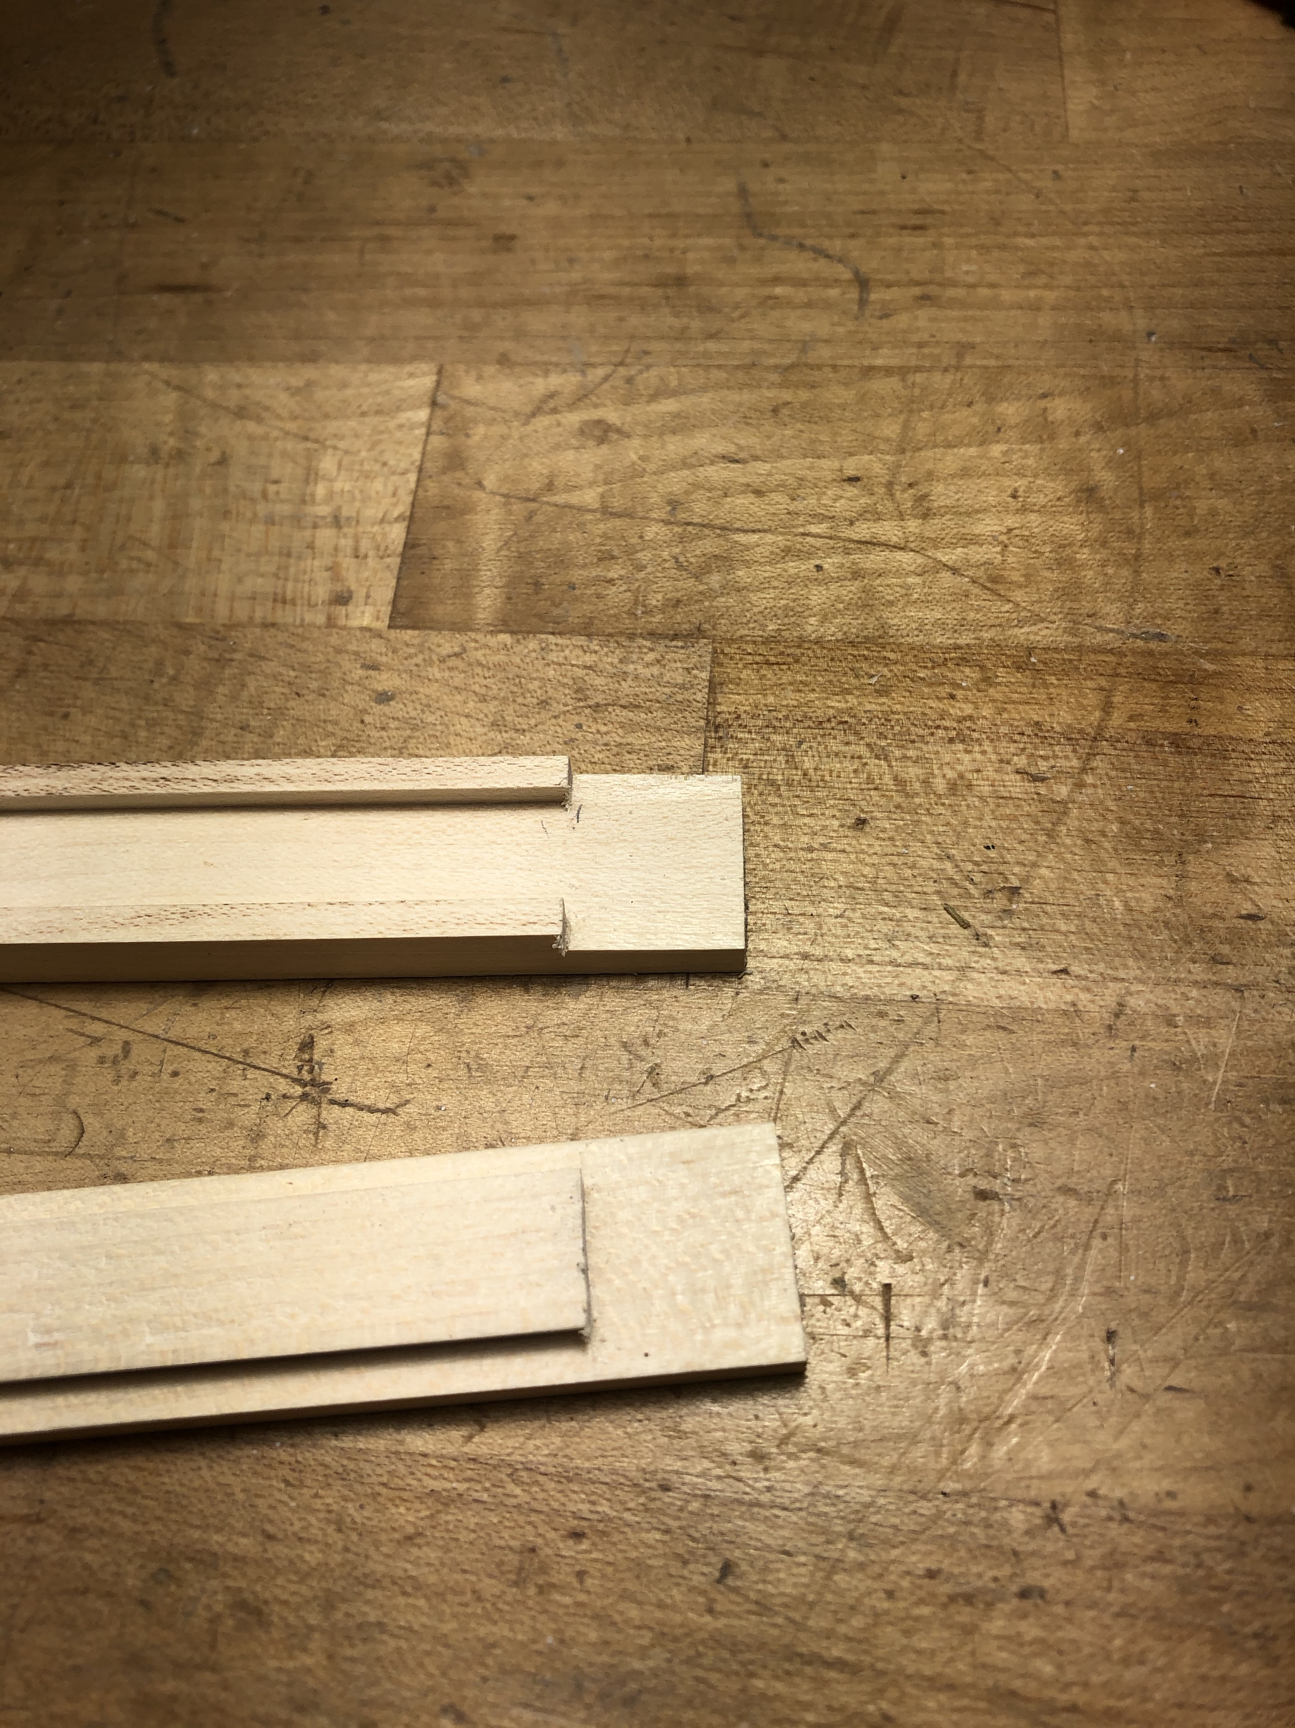
Pieces with interfering parts cut off.

Slide 23
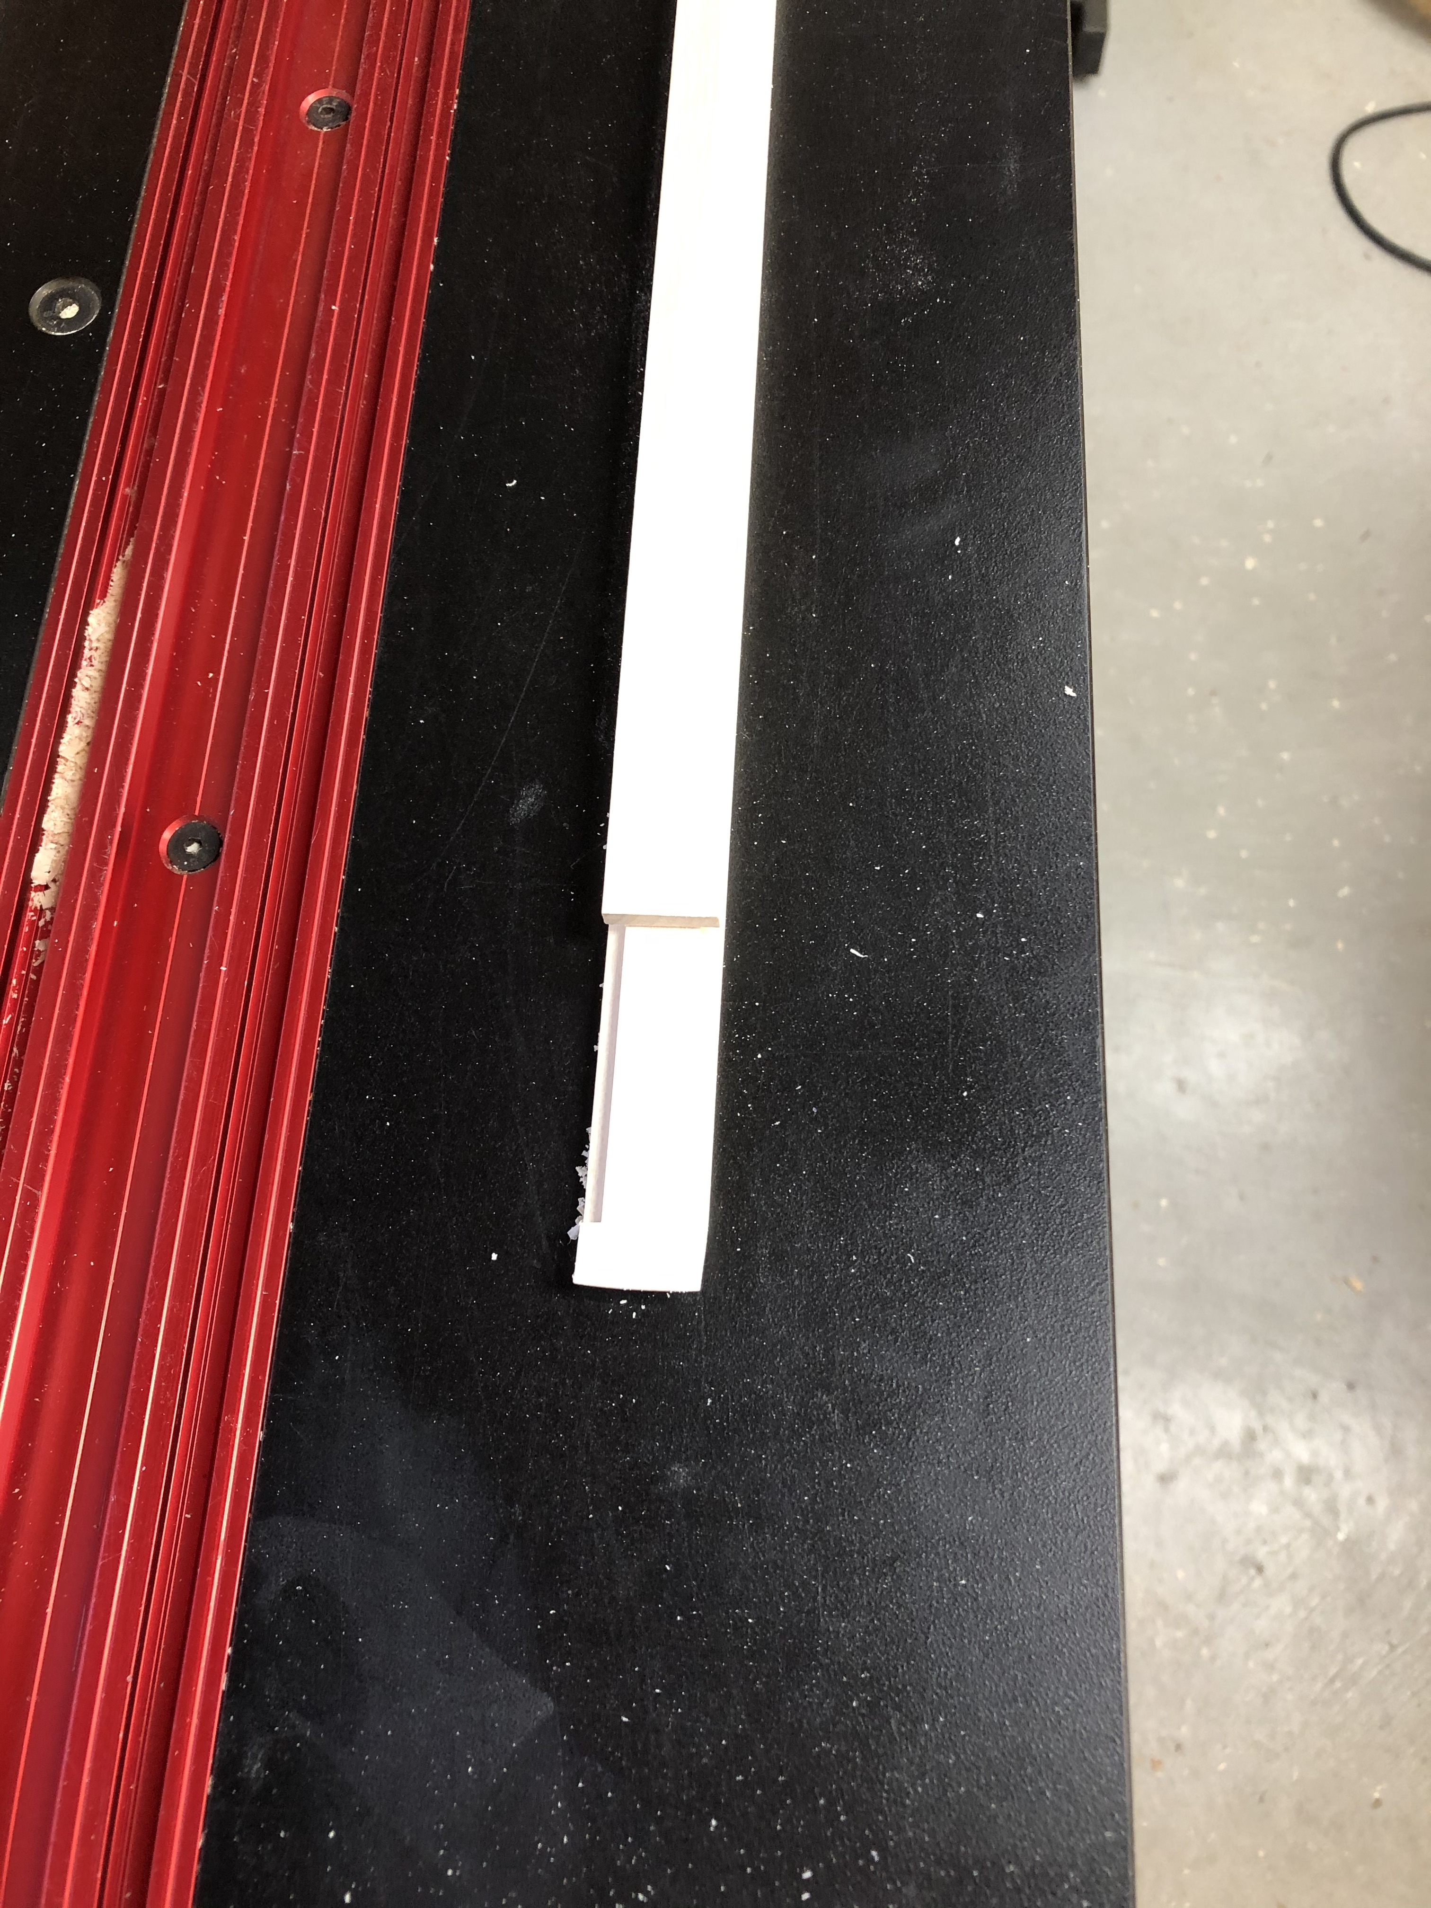
Stick ready to use.

Slide 24
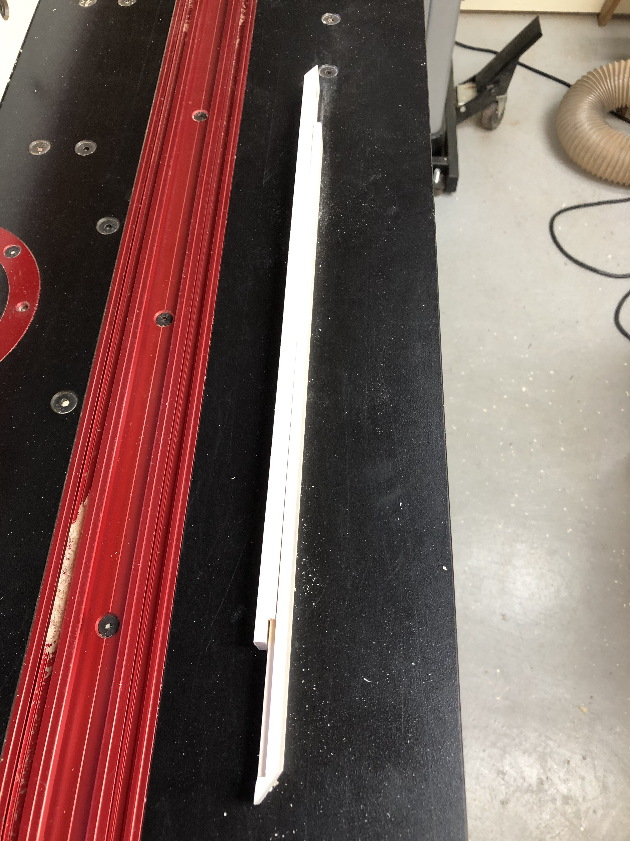
Bevels cut on pieces to allow points of sticks to be in line with each other so that sticks can be used to reach into corners.

